Slide 1
Stimulus Norming: Rating task

Slide 2
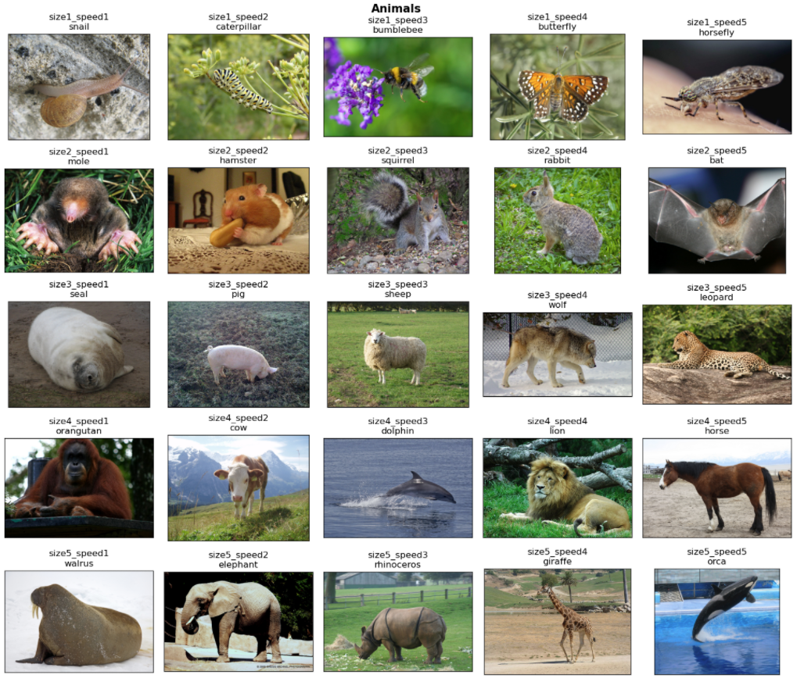
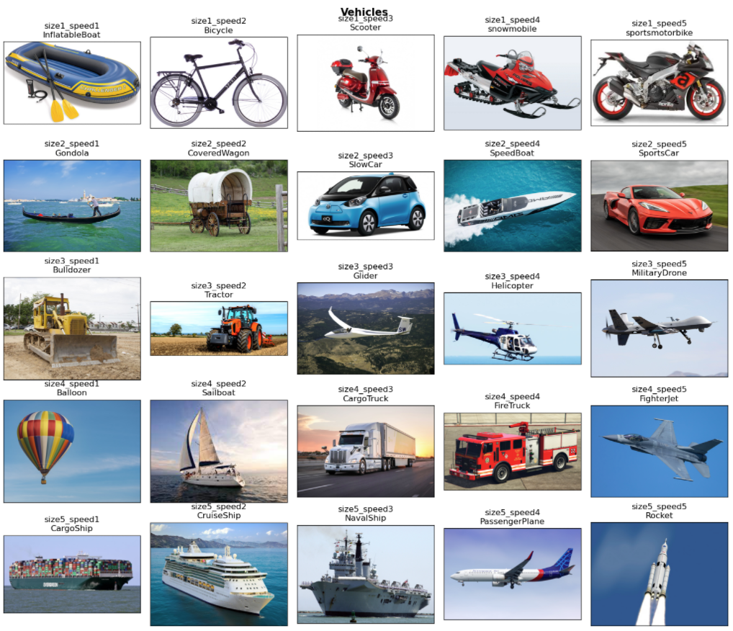
“Ground truth” dimensions

Slide 3
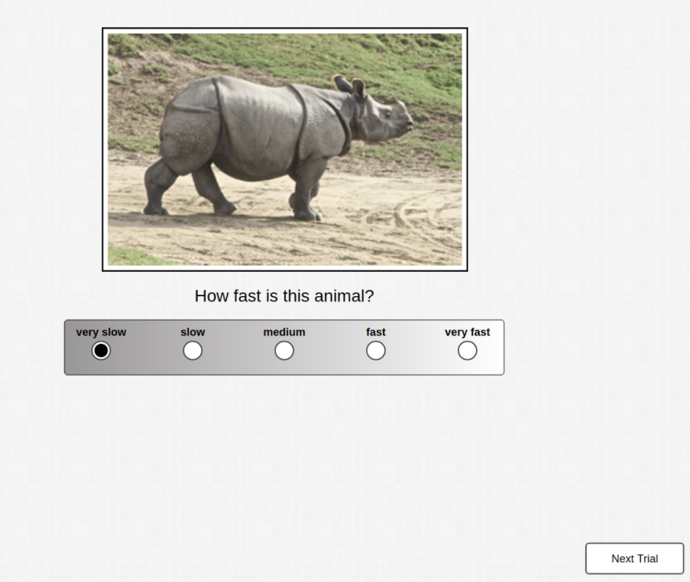
Task Design & Participants
30 participants per dimension & domain
Animals-speed
Animals-size
Vehicles-speed
Vehicles-size
250 trials (10 per size/speed combination) per participant

Slide 4
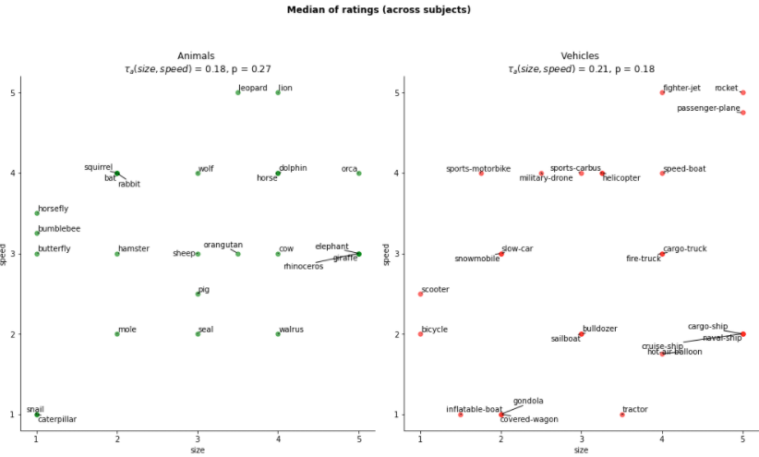
Coverage of 5x5 space

Slide 5
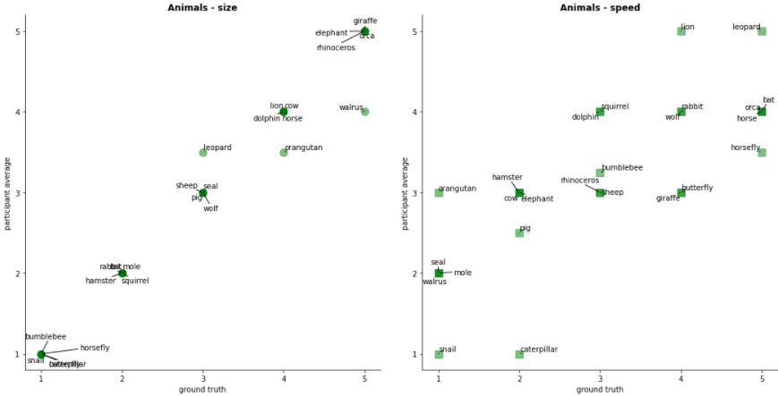
Agreement between “ground truth” and participant ratings - Animals

Slide 6
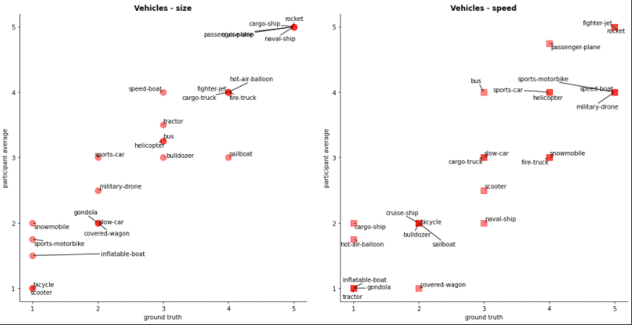
Agreement between “ground truth” and participant ratings - Vehicles

Slide 7
Animals/Vehicles Task 1
Can we replicate Flesch et al, 2018 with abstract dimensions?

Slide 8
Hypotheses
Humans are able to learn categorisation rules with abstract dimensions
Size/speed of animals/vehicles: No physical property of image, requires background knowledge
Participants perform better under blocked than interleaved training
Participants find it easier to learn boundaries under blocked training
Under interleaved training: stronger bias in boundary estimate toward single bound (collapse across tasks)

Slide 9

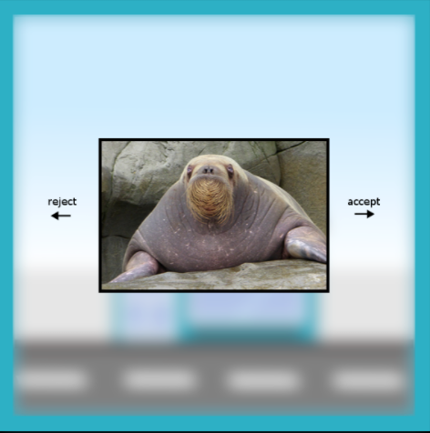
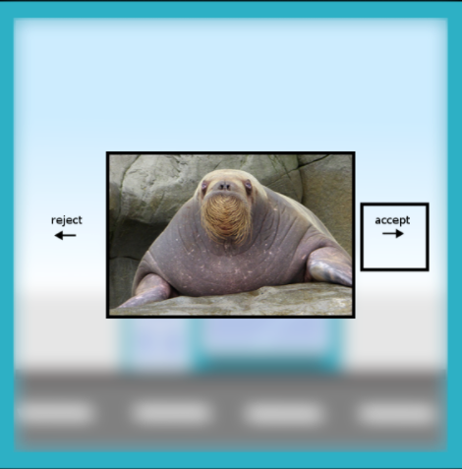
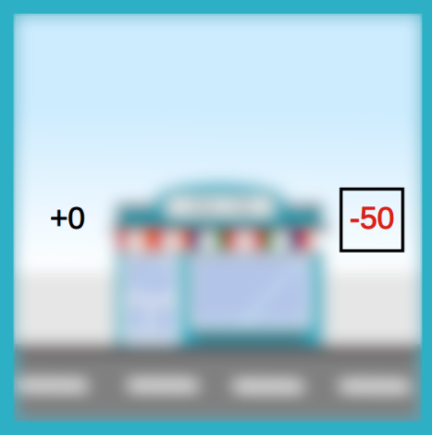
Task Design & Participants
“Speed”
“Size”
“Speed”
Training Curriculum
Vehicles – Blocked (n=100) | Vehicles – Interleaved (n=100)
Animals – Blocked (n=100) | Animals – Interleaved (n=100)
“Size”
Stimulus Domain
Training Phase
Test Phase
Interleaved
blocked

Slide 10
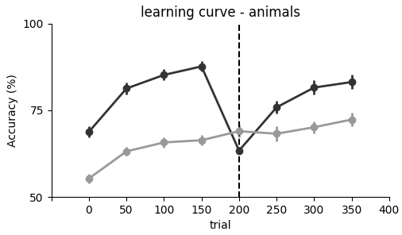
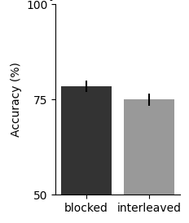
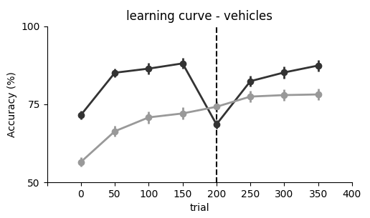
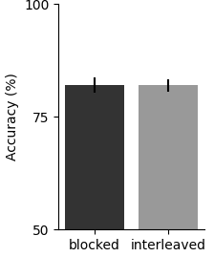
Accuracy
test phase
n.s.
test phase
n.s.

Slide 11
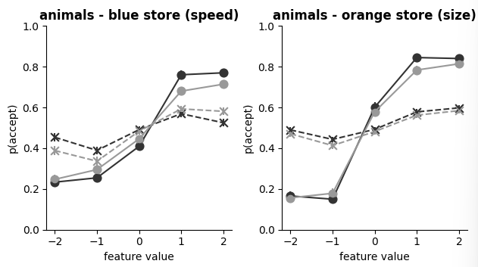
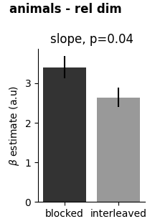
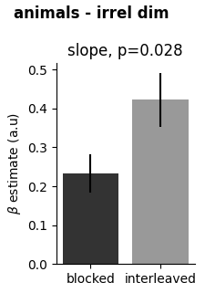
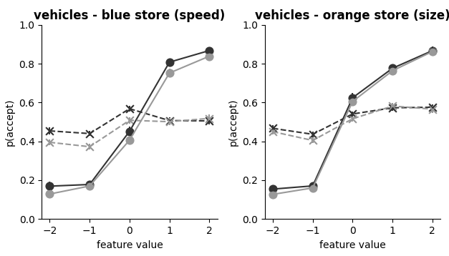
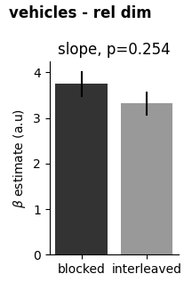
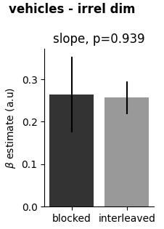
Psychometrics

Slide 12
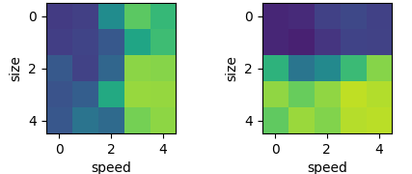
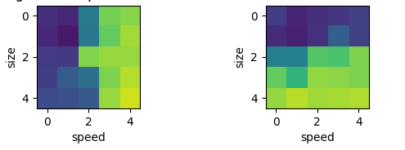
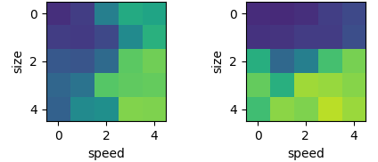
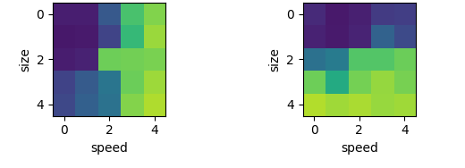
Choice Patterns
animals
vehicles
blocked
blocked
interleaved
interleaved

Slide 13
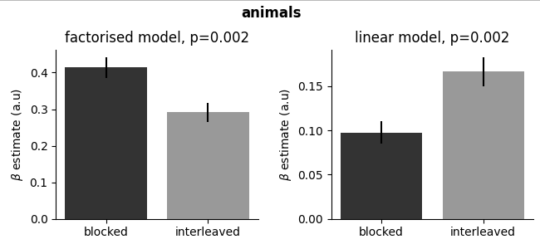
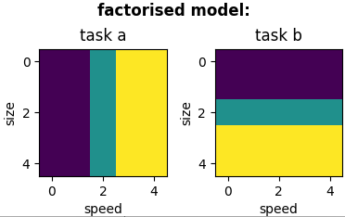
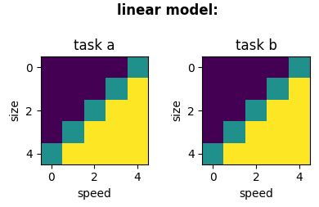
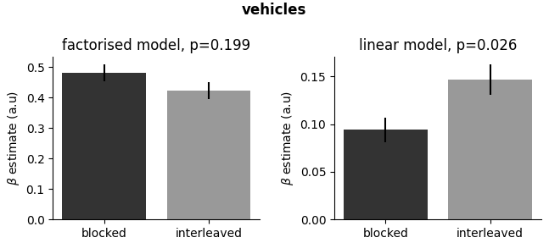
Choice Patterns

Slide 14
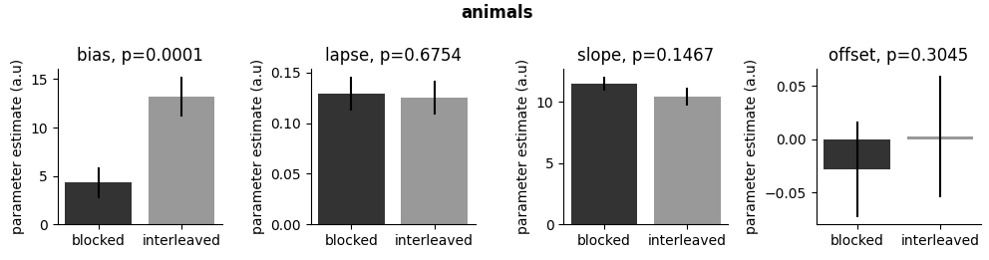
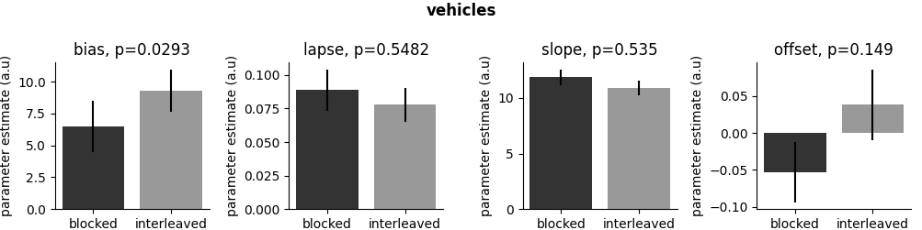
Psychophysical Model

Slide 15
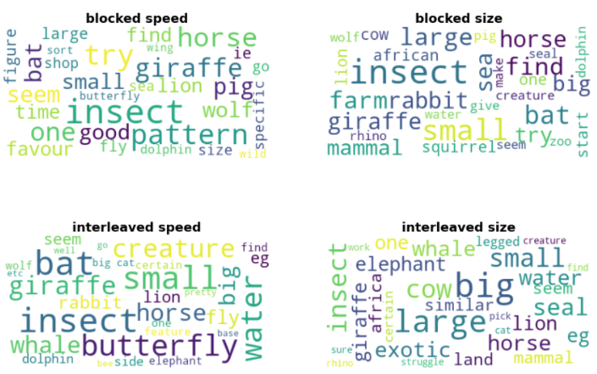
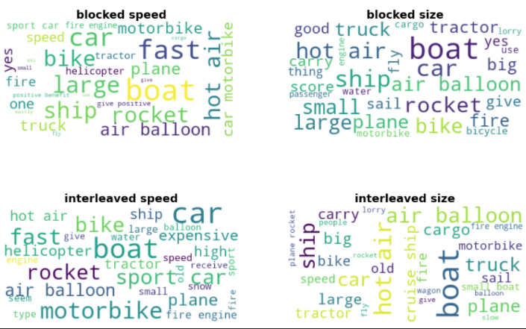
Word clouds of written responses
Animals
Vehicles

Slide 16
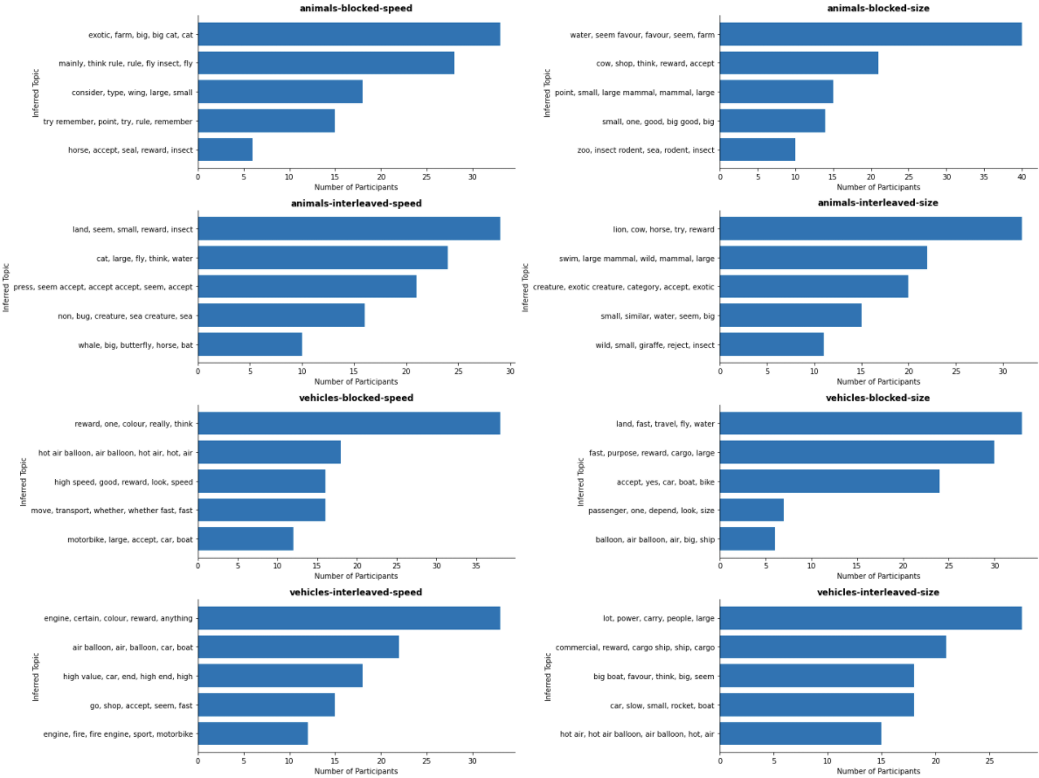
Topic Modelling of written responses

Slide 17
Conclusions
Participants can learn the tasks, but don’t perform exceptionally well
For those trained on the animals domain, blocking confers a benefit
No difference between groups trained on vehicles domain
Analysis of written responses suggest that they found it difficult to infer rules, or at least to verbalise them
Or cohorts maybe a mixture of “rote-learners” and “abstract learners” ?

Slide 18
Animals/Vehicles Task 2
Can participants generalise across domains?

Slide 19
Hypotheses
Previous experiment showed that participants are able to learn abstract categorisation rules (size/speed)
But cohorts maybe mixture of those who learned abstract rules (abstract learners) and those who memorised stimulus-response associations (rote-learners)
If the learned rules were truly abstract (instead of exemplar-based), they should generalise across domains (i.e. from animals to vehicles)
Blocked learning should lead to better generalisation (as participants learned accurate estimates of bounds)
(but why should blocked training lead to less rote-learning? Perhaps interaction with cognitive demands of task?)

Slide 20
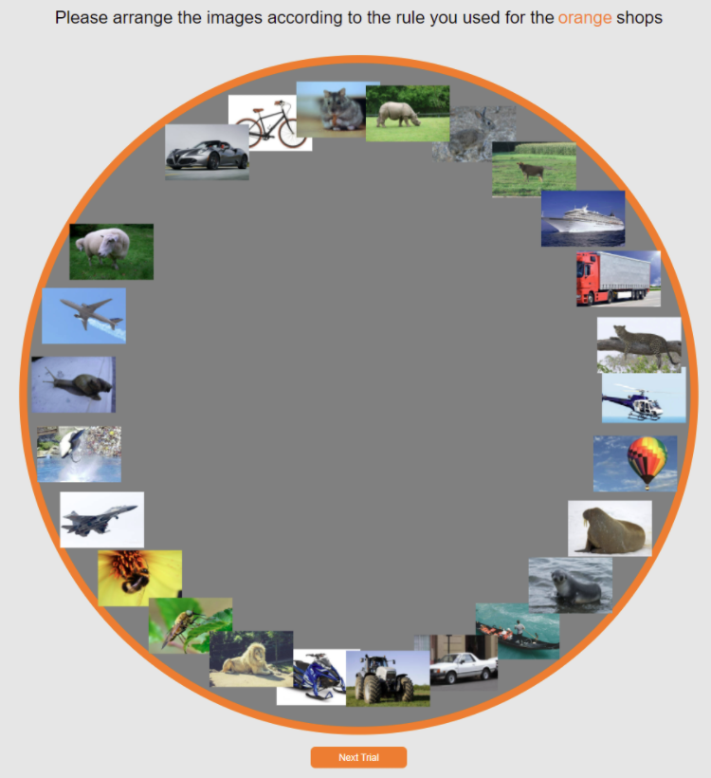
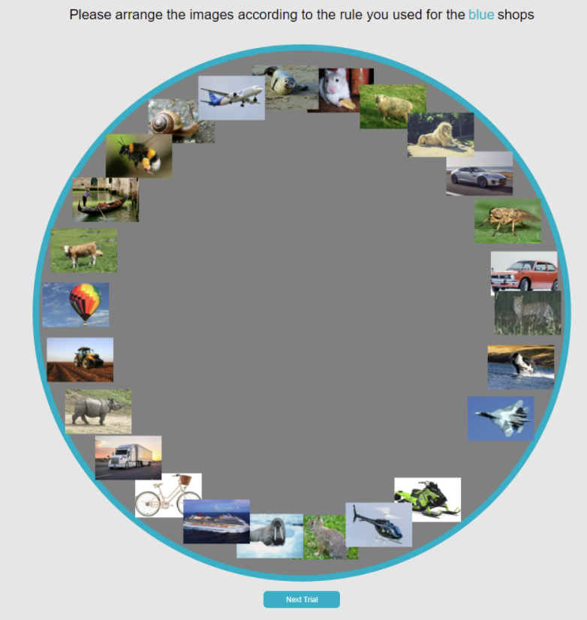
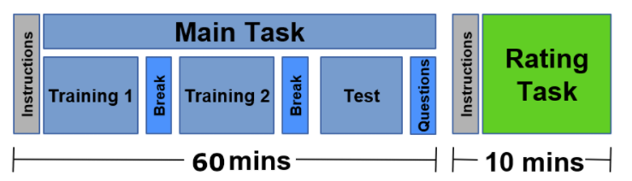
Task Design & Participants
Training Phase
Test Phase
Training Curriculum
Vehicles – Blocked (n=50) | Vehicles – Interleaved (n=50)
Animals – Blocked (n=50) | Animals – Interleaved (n=50)
Interleaved
Base domain
Stimulus Domain
Transfer domain
blocked

Slide 21
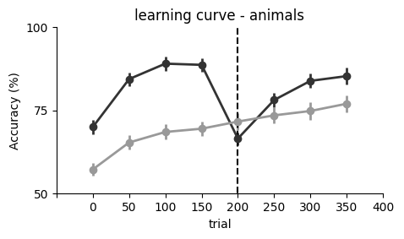
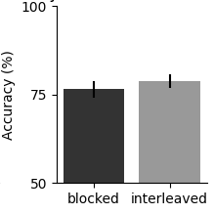
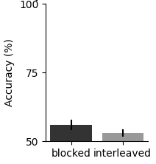
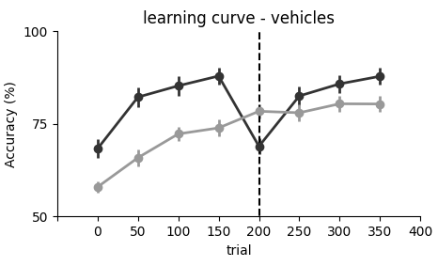
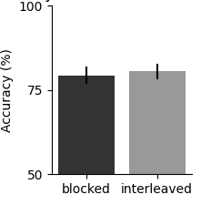
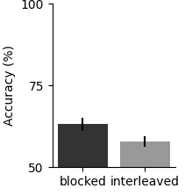
Accuracy
test (base)
test (transfer)
n.s.
n.s.
test (base)
test (transfer)
n.s.
* (p=0.045 …)

Slide 22
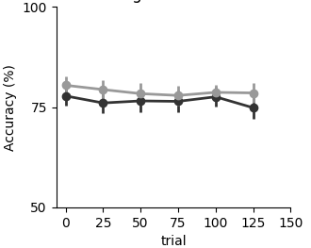
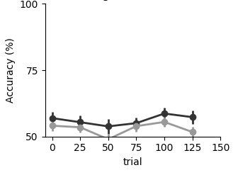
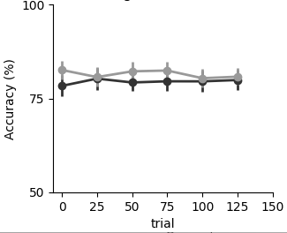
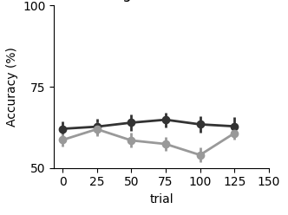
Test phase learning curves
test (base)
test (transfer)
trained on animals
test (base)
test (transfer)
trained on vehicles

Slide 23
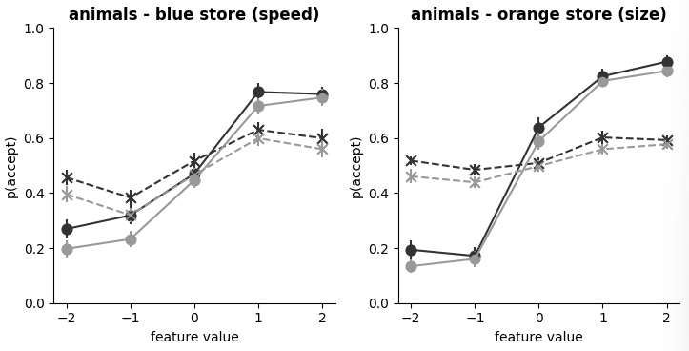
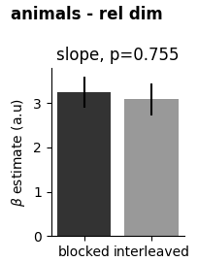
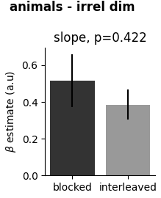
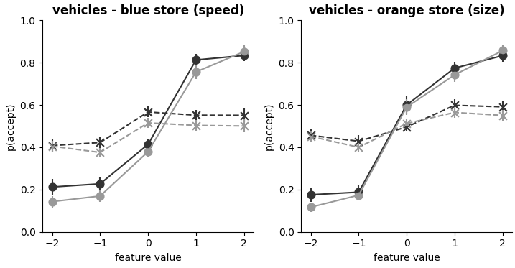
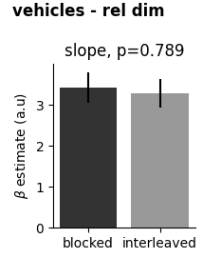

Psychometrics – base task

Slide 24






Psychometrics – transfer task

Slide 25












Choice Patterns
Animals – base task
Animals – transfer task (to vehicles)
Vehicles – base task
Vehicles – transfer task (to animals)
blocked
blocked
blocked
blocked
interleaved
interleaved
interleaved
interleaved

Slide 26




Choice Patterns
Animals – base task
Vehicles – base task
Animals – transfer task (to vehicles)
Vehicles – transfer task (to animals)

Slide 27




Psychophysical Model
Animals – base task
Vehicles – base task
Animals – transfer task (to vehicles)
Vehicles – transfer task (to animals)

Slide 28


Word clouds of written responses
Animals
Vehicles
Todo: perhaps correlate wordfreqs with transfer performance? (exploratory…)

Slide 29

Topic Modelling of written responses

Slide 30


Arena task

Slide 31
Animals/Vehicles Task 3
Partial training feedback for cross-domain transfer

Slide 32
Hypotheses
If we give participants feedback only on subset of training trials,
this might motivate them to learn abstract rules, rather than stimulus-
response contingencies
No feedback

Slide 33
Task Design & Participants
Training Phase
Test Phase
Training Curriculum
Vehicles – Blocked (n=50) | Vehicles – Interleaved (n=50)
Animals – Blocked (n=50) | Animals – Interleaved (n=50)
Interleaved
Base domain
Stimulus Domain
Transfer domain
blocked

Slide 34






Accuracy
test (base)
test (transfer)
n.s.
n.s.
test (base)
test (transfer)
n.s.
n.s.

Slide 35




Test phase learning curves
test (base)
test (transfer)
trained on animals
test (base)
test (transfer)
trained on vehicles

Slide 36


Psychometrics – base task

Slide 37


Psychometrics – transfer task

Slide 38




Choice Patterns
Animals – base task
Vehicles – base task
Animals – transfer task (to vehicles)
Vehicles – transfer task (to animals)

Slide 39




Psychophysical Model
Animals – base task
Vehicles – base task
Animals – transfer task (to vehicles)
Vehicles – transfer task (to animals)

Slide 40


Word clouds of written responses
Animals
Vehicles

Slide 41
Next steps
Interpretation:
Search space too large? Previously shown that those with prior on right dimensions performed particularly well under blocked
Other paradigms:
Length of training: participants might first rote learn and then transition to abstract rules
But what if they are satisfied with performance -> what would drive this transition?
No need to learn abstract rules. Perhaps give test trials with other domain during training?
But this would change nature of task
Curriculum learning. Evidence that distal trials first might help them to find rules?
Instructions: give shopping list of potential dimensions
With explicit rule instructions: understand “noise ceiling”, i.e. how good participants could potentially be
Analyses:
Evidence for transfer, just the “wrong” rules: regress transfer choices against base choices (+ fact/lin models)
Version with no feedback on subset of trials. Did they just ignore those? Look at accuracy for with and without feedback trials
More conservative rejection criterion (see Leys et al (2018): Detecting outliers: Do not use standard deviation around the mean, use absolute deviation around the median)

